Slide 2
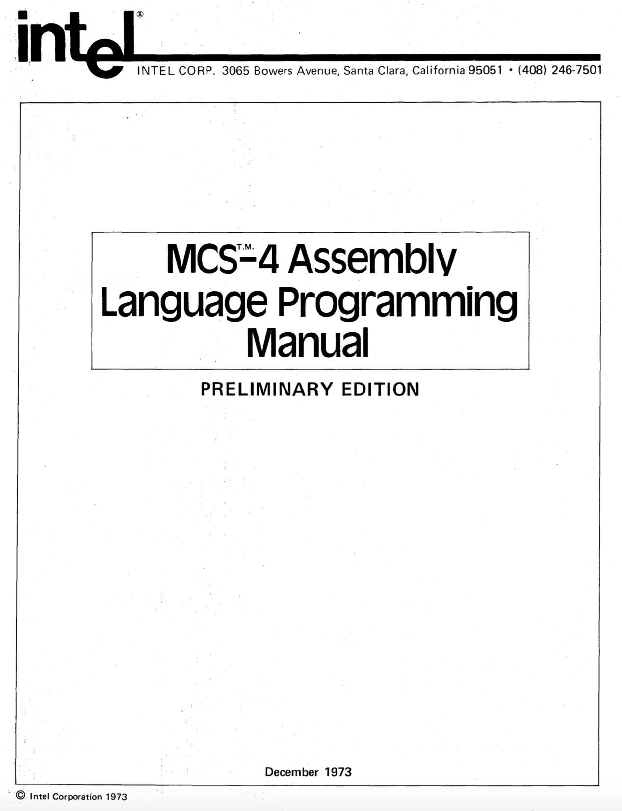

https://github.com/alshapton/Pyntel4004
Assembly Language
Programming Manual
July 2021
Andrew Shapton 2021

Slide 3
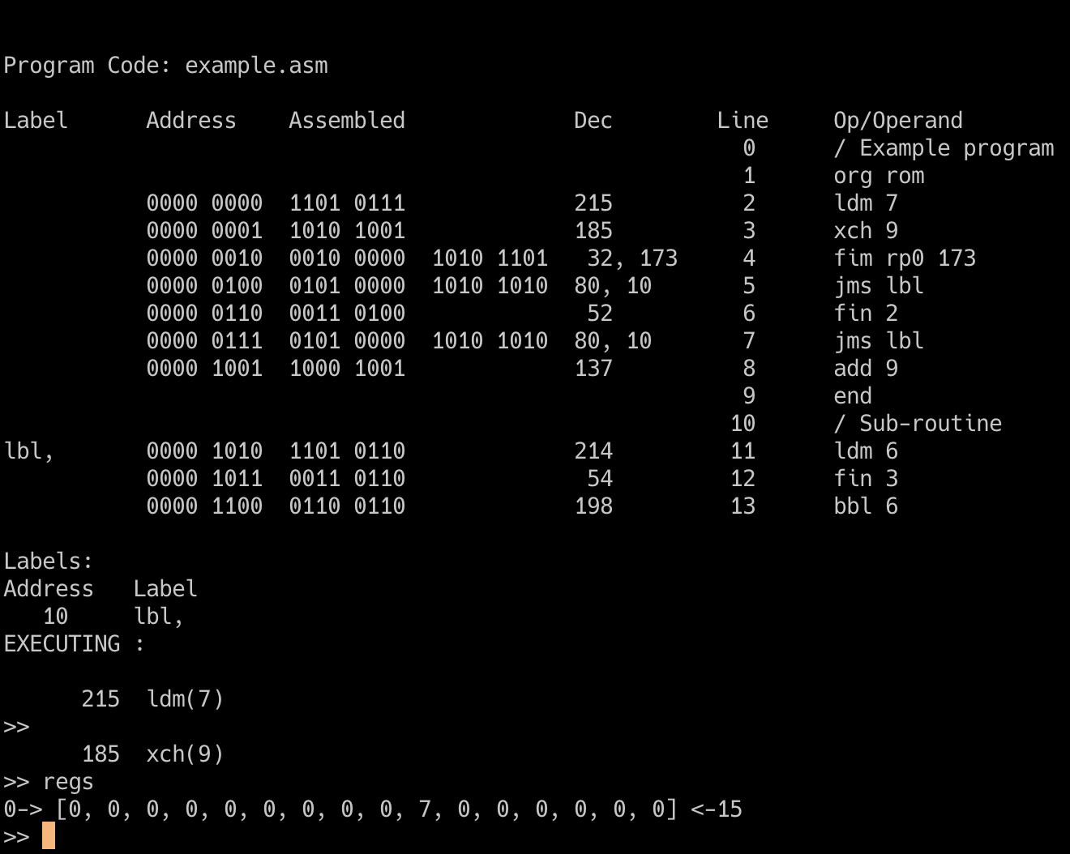
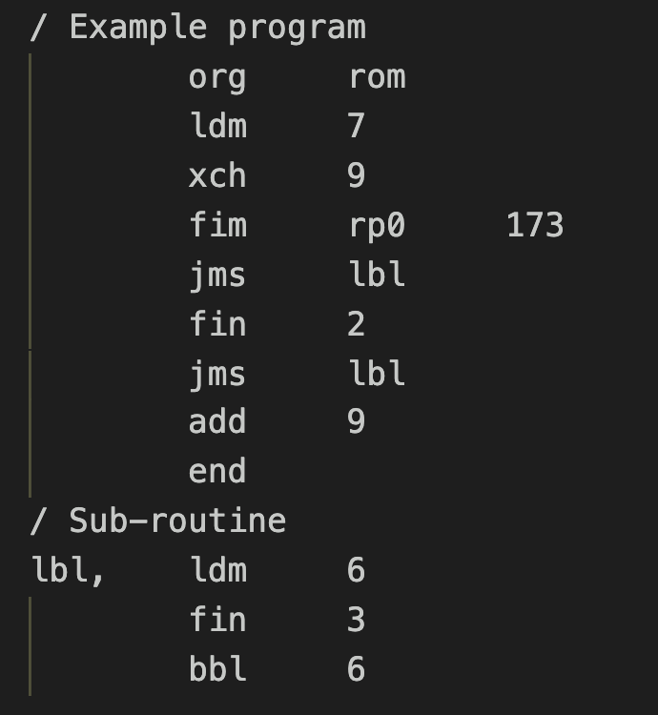

Slide 4
0 0 0 1 C₁ C₂ C₃ C₄
A₂ A₂ A₂ A₂ A₁ A₁ A₁ A₁
If C₁C₂C₃C₄ is true:
A₂A₂A₂A₂ PM A₁A₁A₁A₁ PL
PH unchanged if C₁C₂C₃C₄ is false: (PH) PH
(PM) PM
(PL + 2) PL
C₁ C₂ C₃ C₄
If the indicated Condition Bit is = 1:
Jump if the 4004 Test Signal is = 0
Jump if the Carry Bit is = 1
Jump if the Accumulator = 0
Invert ALL the other conditions
JUMP = C₁ * ((ACC = 0) * C₂ + (carry = 1) * C₃ + TEST * C₄ +
C₁ * (((ACC <> 0) + C₂ ) + ((carry = 0) + C₃ ) * (TEST + C₄ )
JCN

Slide 5
0 0 1 0 R_{p} R_{p} R_{p} 0
D₁ D₂D₃ D₄ D₅ D₆ D₇D₈
0 0 1 0 R_{p} R_{p} R_{p} 0
000 for register pair 0 or 0P
001 for register pair 2 or 1P
010 for register pair 4 or 2P
011 for register pair 6 or 3P
100 for register pair 8 or 4P
101 for register pair 10 or 5P
110 for register pair 12 or 6P
111 for register pair 14 or 7P
8-bit data quantity
000 for register pair 0 or 0P
001 for register pair 2 or 1P
010 for register pair 4 or 2P
011 for register pair 6 or 3P
100 for register pair 8 or 4P
101 for register pair 10 or 5P
110 for register pair 12 or 6P
111 for register pair 14 or 7P
D₁D₂D₃D₄
R_{p} R_{p} R_{p} R_{p}
(RP_{p})
DB(x2)
(RRRO) --> DB (X2) (RRR1) --> DB (X3)
D₅D₆D₇D₈
R_{p+1} R_{p+1} R_{p+1} R_{p+1}
(RP_{p+1})
DB(x3)
FIM
SRC 1

Slide 6
When referring to a DATA Ram character
When referring to a DATA RAM status character
1 of 16 characters within the register
Not relevant
1 of 4 registers within the DATA RAM chip
1 of 4 registers within the DATA RAM chip
1 of 4 DATA RAM chips within the DATA RAM bank previously selected with a DCL instruction
1 of 4 DATA RAM chips within the DATA RAM bank previously selected with a DCL instruction
SRC 2

Slide 7
When referring to RAM output port
When referring to a ROM input/output port
Not relevant
Not relevant
The port associated with 1 of 4 DATA RAM chips within the DATA RAM bank previously selected by a DCL instruction.
The port associated with 1 of 16 ROMs.
SRC 3

Slide 8
0 1 0 0 A₃ A₃ A₃ A₃
A₂ A₂ A₂ A₂ A₁ A₁ A₁ A₁
0 0 1 1 R_{p} R_{p} R_{p} 1
12-bit address
000 for register pair 0 or 0P
001 for register pair 2 or 1P
010 for register pair 4 or 2P
011 for register pair 6 or 3P
100 for register pair 8 or 4P
101 for register pair 10 or 5P
110 for register pair 12 or 6P
111 for register pair 14 or 7P
A₃ A₃ A₃ A₃
P_{H}
A₂ A₂ A₂ A₂
P_{M}
JUN
A₁ A₁ A₁ A₁
P_{L}
1 1 0 0 D D D D
P_{H}
P_{H}
unchanged
R_{p} R_{p} R_{p} R_{p}
P_{M}
R_{p+1} R_{p+1} R_{p+1} R_{p+1}
P_{L}
4-bit data item
(Stack)
PL, PM, PH
DDDD
ACC
BBL
JIN

Slide 9
0 1 0 1 A₃ A₃ A₃ A₃
A₂ A₂ A₂ A₂ A₁ A₁ A₁ A₁
0 0 1 1 R_{p} R_{p} R_{p} 0
12-bit address
000 for register pair 0 or 0P
001 for register pair 2 or 1P
010 for register pair 4 or 2P
011 for register pair 6 or 3P
100 for register pair 8 or 4P
101 for register pair 10 or 5P
110 for register pair 12 or 6P
111 for register pair 14 or 7P
A₃ A₃ A₃ A₃
P_{H}
A₂ A₂ A₂ A₂
P_{M}
A₁ A₁ A₁ A₁
JMS
P_{L}
1 1 1 0 1 1 S S
( (P_{H}) . (R₀) . (R₁) ) RP_{p}
OR
( (P_{H+1}) . (R₀) . (R₁) ) RP_{p}
MSn
ACC
00 for Character 0
01 for Character 1
10 for Character 2
11 for Character 3
RDn
FIN

Slide 10
0 1 1 1 R R R R
A₂ A₂ A₂ A₂ A₁ A₁ A₁ A₁
0 1 1 0 R R R R
0000 for Register 0
0001 for Register 1
0010 for Register 2
0011 for Register 3
0100 for Register 4
0101 for Register 5
0110 for Register 6
0111 for Register 7
1000 for Register 8
1001 for Register 9
1010 for Register 10
1011 for Register 11
1100 for Register 12
1101 for Register 13
1110 for Register 14
1111 for Register 15
8-bit address
0000 for Register 0
0001 for Register 1
0010 for Register 2
0011 for Register 3
0100 for Register 4
0101 for Register 5
0110 for Register 6
0111 for Register 7
1000 for Register 8
1001 for Register 9
1010 for Register 10
1011 for Register 11
1100 for Register 12
1101 for Register 13
1110 for Register 14
1111 for Register 15
(RRRR) + 1
RRRR
If result = 0
(P_{H})
P_{H}
(P_{M})
P_{M}
(P_{L}+2)
P_{L}
If result <> 0
(P_{H})
P_{H}
(A₂ A₂ A₂ A₂)
P_{M}
(A₁ A₁ A₁ A₁)
P_{L}
ISZ
(RRRR) + 1
INC
RRRR
A₃ A₃ A₃ A₃
P_{H}
A₂ A₂ A₂ A₂
P_{M}
A₁ A₁ A₁ A₁
P_{L}
( (P_{H}) . (R₀) . (R₁) ) RP_{p}
OR
( (P_{H+1}) . (R₀) . (R₁) ) RP_{p}

Slide 11
1 1 1 1 1 1 0 0
1 0 0 1 R R R R
1 0 0 0 R R R R
(ACC)
KBP
ROM
0000 for Register 0
0001 for Register 1
0010 for Register 2
0011 for Register 3
0100 for Register 4
0101 for Register 5
0110 for Register 6
0111 for Register 7
1000 for Register 8
1001 for Register 9
1010 for Register 10
1011 for Register 11
1100 for Register 12
1101 for Register 13
1110 for Register 14
1111 for Register 15
0000 for Register 0
0001 for Register 1
0010 for Register 2
0011 for Register 3
0100 for Register 4
0101 for Register 5
0110 for Register 6
0111 for Register 7
1000 for Register 8
1001 for Register 9
1010 for Register 10
1011 for Register 11
1100 for Register 12
1101 for Register 13
1110 for Register 14
1111 for Register 15
ACC
KBP
1 1 1 1 1 0 1 1
(ACC) + (0000 or 0110)
ACC
DAA
1 1 1 1 1 0 0 1
ACC
1011 If (CY) = 0
ACC
1010 If (CY) = 1
(ACC) + (RRRR) + (CY) ACC, CY
CY
0
TCS
SUB
(RRRR) + (ACC) + (CY) ACC, CY
ADD

Slide 12
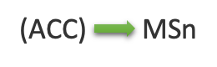

1 1 1 0 0 0 0 0
1 0 1 0 R R R R
1 1 1 0 0 1 S S
(ACC)
M
WRM
0000 for Register 0
0001 for Register 1
0010 for Register 2
0011 for Register 3
0100 for Register 4
0101 for Register 5
0110 for Register 6
0111 for Register 7
1000 for Register 8
1001 for Register 9
1010 for Register 10
1011 for Register 11
1100 for Register 12
1101 for Register 13
1110 for Register 14
1111 for Register 15
LD
00 for Character 0
01 for Character 1
10 for Character 2
11 for Character 3
1 1 1 1 0 0 0 1
WRn
CY
CLC
0
1 1 0 1 D D D D
1 1 1 1 1 0 1 0
DDDD
ACC
4-bit data item
CY
1
STC
LDM

Slide 13
1 1 1 1 1 0 0 0
1 0 1 1 R R R R
1 1 1 0 0 0 0 1
(ACC) - 1
ACC
(ACC)
RAM Output Register
0000 for Register 0
0001 for Register 1
0010 for Register 2
0011 for Register 3
0100 for Register 4
0101 for Register 5
0110 for Register 6
0111 for Register 7
1000 for Register 8
1001 for Register 9
1010 for Register 10
1011 for Register 11
1100 for Register 12
1101 for Register 13
1110 for Register 14
1111 for Register 15
DAC
WMP
1 1 1 0 1 0 0 0
1 1 1 0 0 0 1 0
(ACC)
(M) + (ACC) + (CY) ACC, CY
ACBR
(ACC)
ROM Output Lines
(RRRR)
ACC
SBM
(ACBR)
WRR
RRRR
1 1 1 1 0 0 1 0
1 1 1 1 0 0 0 0
(ACC) + 1
ACC
0
ACC
CY
IAC
0
XCH
CLB

Slide 14
1 1 1 1 1 1 0 1
1 1 1 0 0 0 1 1
CM0
a0
CM1
a1
Data RAM Chip 0 Program RAM
CM2
DCL
a2
1 1 1 1 0 0 1 1
0x4A9
Register 0
4 A B
0x4AA
Register 1
0x4AB
Register 2
0x4AC
CY
(CY)
CMC
Register 3
0x4AD
0x4AE
1 1 1 1 0 1 0 0
Status Characters
a₃ a₂ a₁ a₀
ACC
CMA
(ACC)
WPM
(PRAM)

Slide 15
1 1 1 1 0 1 0 1
1 1 1 1 0 1 1 0
a₀
CY
(CY)
a₀
a_{i+1}
a_{i-1}
a_{i}
a_{i}
CY
a₃
a₃
CY
Carry
Accumulator
Accumulator
Carry
Before RAL
0
1 1 0 1
Before RAR
0 1 1 0
1
RAL operation
0
1 1 0 1
RAR operation
0 1 1 0
1
1 0 1 1
0
After RAL
1
1 0 1 0
After RAR
RAL
RAR

Slide 16
1 1 1 1 0 1 1 1
1 1 1 0 0 1 S S
0 0 1 1 R_{p} R_{p} R_{p} 0
ACC
General representation of a byte
0
Least significant bit of the accumulator
a₀
(CY)
00 for Character 0
01 for Character 1
10 for Character 2
11 for Character 3
CY
0
TCC
1 1 1 0 1 0 1 1
MSn ACC
RDn
(M) + (ACC) + (CY) ACC, CY
1 1 1 0 1 0 1 0
ADM
(ROM input lines) ACC
1 1 1 0 1 0 0 1
I₃ O₂ O₁ I₀ (ACC) 1 X X 0 1 1 (1 or 0) (1 or 0) 0 ROM pins
(M) ACC
RDM
RDR

Slide 17
Multi-digit Addition
3
8
1
C
6 9 F 2 +
A
2
0
E
Data RAM chip 0 before addition
Carry = 1
Carry = 1
Carry = 0
Register 0
C 1 8 3 0 0 0 0 0 0 0 0 0 0 0 0
Register 1
2 F 9 6 0 0 0 0 0 0 0 0 0 0 0 0
Register 2
Register 3
Status Characters
Data RAM chip 0 after addition
Register 0
C 1 8 3 0 0 0 0 0 0 0 0 0 0 0 0
Register 1
E 0 2 A 0 0 0 0 0 0 0 0 0 0 0 0
Register 2
Register 3
Status Characters

Slide 18
Introduction date: |  | November 15, 1971
Type: |  | 4-bit microprocessor (8-bit instructions)
Frequency: |  | 500KHz - 740KHz
Technology: |  | P-channel silicon gate MOS technology
Number of transistors: |  | 2,300 (10 microns)
Addressable Memory |  | 4096x8-bit ROM and 1280x4-bit RAM
Number of Instructions |  | 45 with a 4 level stack and sixteen 4-bit (or eight 8-bit) registers
History: |  | In 1969 Busicom asked Intel to design a set of chips to be used in a new high perfomance calculator. Ted Hoff, Federico Faggin and Stan Mazor came up with a design that involved a central processing unit, 4004 (CPU) a read-only memory, 4001 (ROM) a random access memory, 4002 (RAM) and a shift register, 4003 (I/O). The CPU was eventually to be called a microprocessor. Later Intel negotiated for a return of the rights for the chips, which had gone to Busicom in the original contract.
Second source: |  | National Semiconductors was the only second source to Intel 4004.
Reset
9
8
Sync-Out
Test
10
7
Clk Phase 2
Memory
Control
Output
CM-ROM
Clk Phase 1
11
6
V_{DD}
12
5
V_{SS}
i4004
PINS
CM-RAM3
13
4
D3
9
8
10
7
CM-RAM2
14
3
D2
11
Memory
Control
Outputs
Data
Bus
I/O
6
12
5
CM-RAM1
15
2
D1
13
4
3
CM-RAM0
16
1
D0
14
15
2
16
1

Slide 19
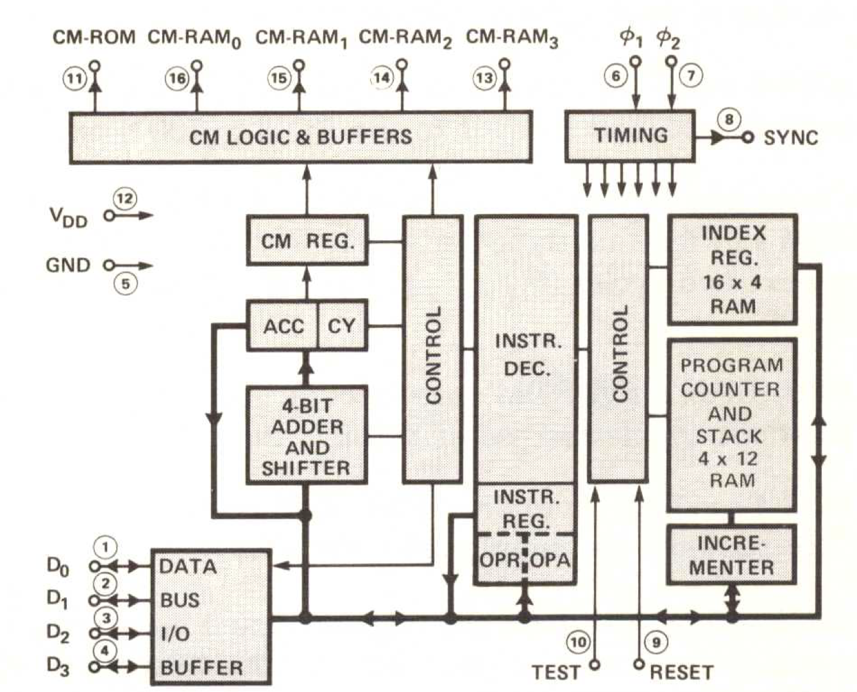
CM-ROM
CM-RAM₀
CM-RAM₀
CM-RAM₀
CM-RAM₀
⏀₁
⏀₂
Intel 4004
11
16
15
14
13
6
7
CM LOGIC AND BUFFERS
TIMING
SYNC
8
CM REGISTER
INSTRUCTION
DECODER
INDEX REGISTER
16 X 4 RAM
INSTRUCTION
DECODER
ACC
CY
PROGRAM COUNTER & STACK
4 X 12 RAM
V_{DD}
12
CONTROL
CONTROL
GND
5
INSTRUCTION
REGISTER
4-BIIT
ADDER
AND SHIFTER
OPR
OPA
INCREMENTER
DATA
BUS
I/O
BUFFER
D₀
1
D₁
2
D₂
3
D₃
4
10
9
TEST
RESET

Slide 20
Introduction date: |  | 1971
Type: |  | 10-bit Serial-in/Parallel-out, Serial-out Shift Register.
Memory: |  | 256 x 8-bit
Technology: |  | P-channel silicon gate MOS technology
Number of transistors:
History: |  | The 4003 was designed to be used with other MCS-4/40 devices such as the 4004 CPU.
Second Source |  | National Semiconductors was the only second source.
Q₅
9
8
Q₄
Q₆
10
7
Q₃
Parallel
Output
Parallel
Output
Q₇
11
Q₂
6
Q₈
12
5
V_{SS}
i4003
PINS
Q₉
13
4
Q₁
9
8
Parallel
Output
10
7
O₂
14
3
Q₀
11
6
12
5
Serial Out
O₁
15
2
Data In
13
4
3
Enable Input
O₀
16
1
Clock Pulse Input
14
15
2
16
1

Slide 21
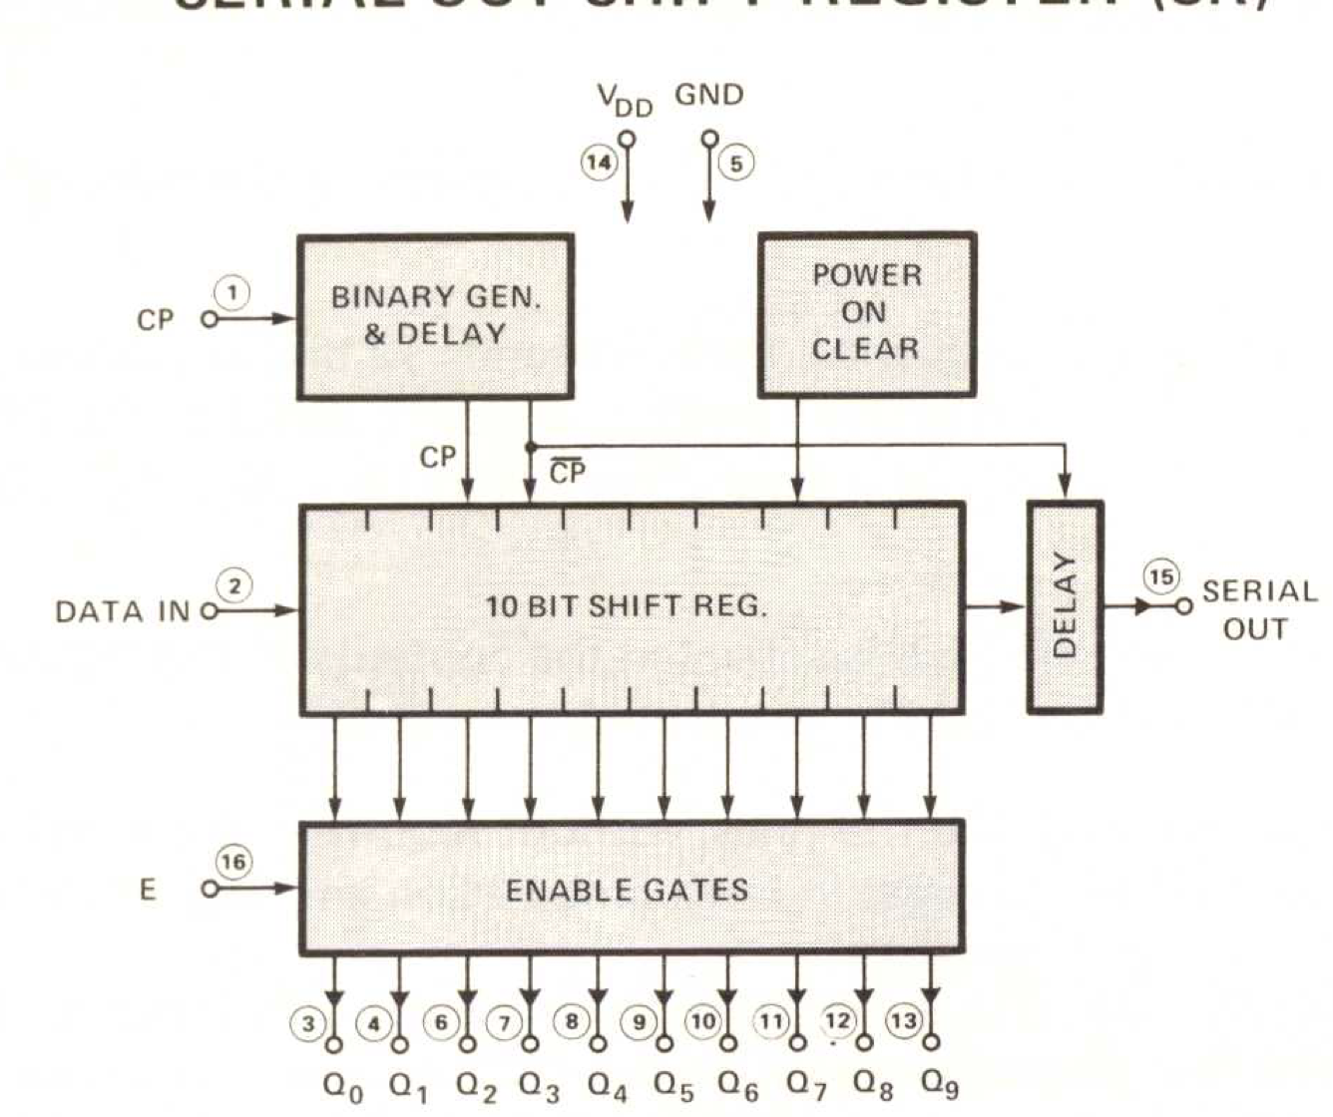
V_{DD}
GND
Intel 4003
BINARY GEN. & DELAY
14
5
POWER ON CLEAR
CP
1
CP
CP
10 BIT SHIFT REGISTER
DATA IN
DELAY
SERIAL OUT
2
15
ENABLE GATES
E
16
3
4
6
7
8
9
10
11
12
13
Q₀
Q₁
Q₂
Q₃
Q₄
Q₅
Q₆
Q₇
Q₈
Q₉

Slide 22
Introduction date: | 1971
Type: | 320-bit MOS RAM and 4-bit output port.
Memory: | 80 x 4-bit
Technology: | P-channel silicon gate MOS technology
History: | The 4002 was designed to be used with other MCS-4/40 devices such as the 4004 CPU. The chip was available in two different metal options 4002-1 and 4002-2 this was to make it possible to extend the chip selection so that 4pcs of 4002 chips could be connected to the 4004 CPU without any external chip selection logic.
Second source: | National Semiconductors was the only second source.
Reset
9
8
Sync-Out
Chip Select
Input
P₀
10
7
Clk Phase 2
Memory
Control
Input
CM
Clk Phase 1
11
6
V_{DD}
12
5
V_{SS}
i4002
PINS
O₃
13
4
D3
9
8
10
7
O₂
14
3
D2
11
Output
Lines
Data
Bus
I/O
6
12
5
O₁
15
2
D1
13
4
3
O₀
16
1
D0
14
15
2
16
1

Slide 23
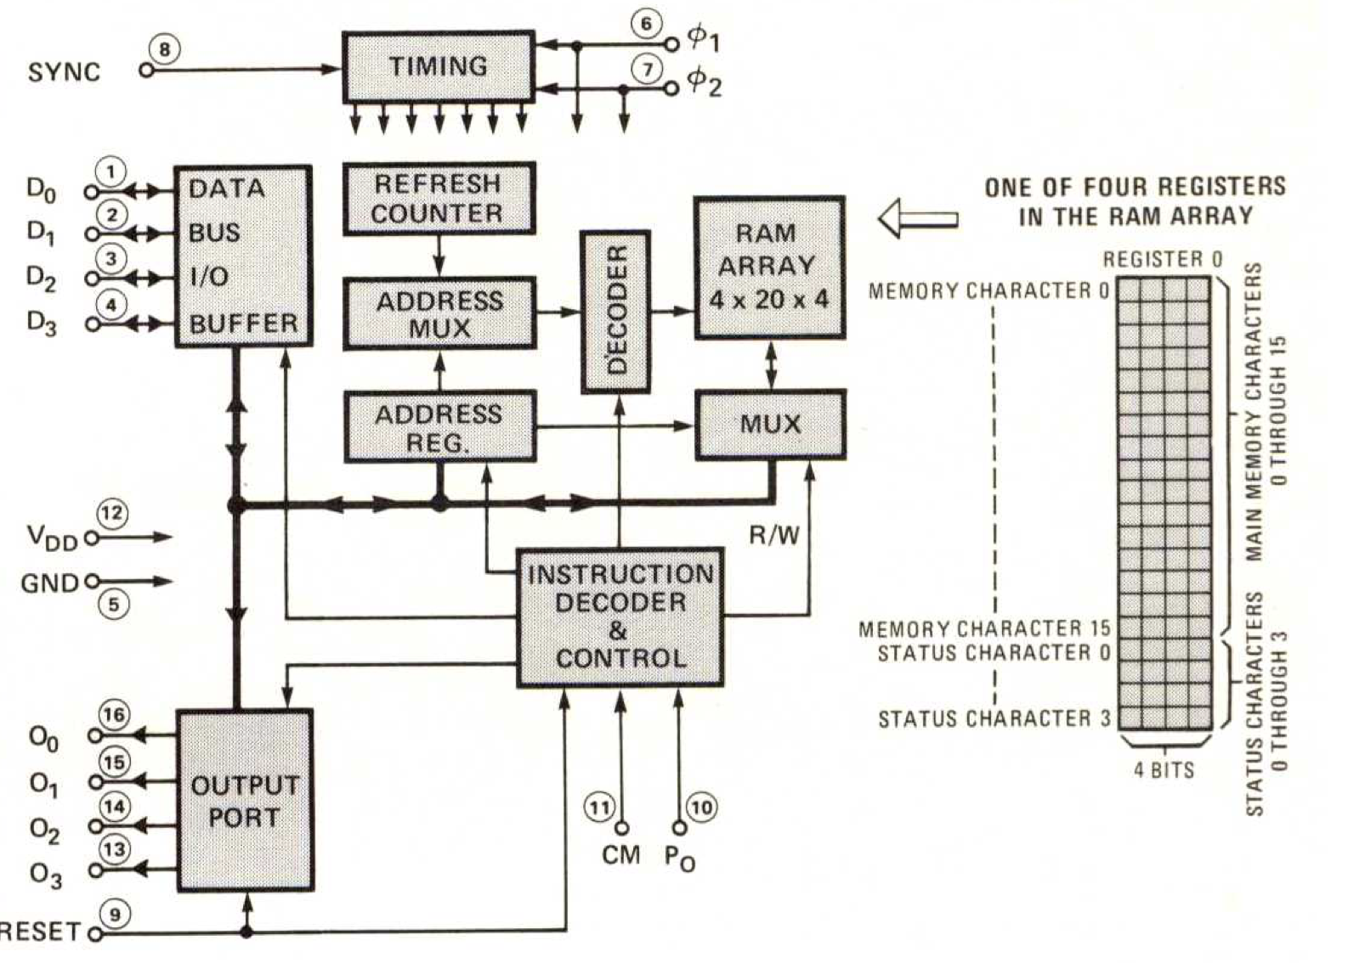
X₂
X₃
D₃ D₂
Chip #
(0 through 3)
D₁ D₀
Register #
(0 through 3)
D₃ D₂ D₁ D₀
Main Memory Character #
(0 through 15)
ONE OF THE 4 REGISTERS
IN THE RAM ARRAY
Register 0
TIMING
6
⏀₁
MEMORY CHARACTER 0
Intel 4002
SYNC
8
7
⏀₂
DATA
BUS
I/O
BUFFER
REFRESH
COUNTER
D₀
1
RAM
ARRAY
4 X 20 X 4
D₁
2
ADDRESS
MUX
DECODER
D₂
3
D₃
4
ADDRESS
REGISTER
MAIN MEMORY CHARACTERS
0 THROUGH 15
MUX
V_{DD}
12
GND
5
INSTRUCTION DECODE & CONTROL
R/W
I/O₀
16
OUTPUT PORT
I/O₁
MEMORY CHARACTER 15
15
I/O₂
STATUS CHARACTER 0
14
I/O₃
13
11
10
STATUS CHARACTERS
0 THROUGH 3
CM
P₀
RESET
9
STATUS CHARACTER 3
4-bits

Slide 24
Individual Registers
Register Layout
Register 0
0
1
Register 1
Decimal
Address
Hexadecimal
Address
Register 2
2
3
Register 3
8 Bits
Register 4
4
5
Register 5
0
255
256
511
3840
4095
0
FF
100
1FF
F00
FFF
Register 6
6
7
Register 7
Page 0
Register 8
8
9
Register 9
Register 10
10
11
Register 11
Register 12
12
13
Register 13
Page 1
Register 14
14
15
Register 15
Register Pair 0 or 0P
0
1
Register Pair 2 or 1P
2
3
Register Pair 4 or 2P
4
5
Register Pair 6 or 3P
6
7
Register Pair 8 or 4P
8
9
Register Pair 10 or 5P
10
11
Page 15
Register Pair 11 or 6P
12
13
Register Pair 12 or 7P
14
15
Register Pairs

Slide 25
Data RAM bank organisation
DCL Instruction selects 1 of 8 Data RAM banks
Data RAM Chip 0
Data RAM Chip 0
Data RAM Chip 0
Data RAM Chip 1
Data RAM Chip 1
Data RAM Chip 1
Data RAM Chip 2
Data RAM Chip 2
Data RAM Chip 2
Data RAM Chip 3
Data RAM Chip 3
Data RAM Chip 3
Data RAM bank 0
Data RAM bank 1
Data RAM bank 7

Slide 26
Data RAM chip 0 organisation
4 Specially Addressable 4-bit
status characters per Data RAM Register
Decimal
Address
Hexadecimal
Address
16 Directly Addressable 4-bit characters per Data RAM Register
0 - 15
00 – 0F
Data RAM Register 0
16 - 31
10 – 1F
Data RAM Register 1
32 - 47
20 – 2F
Data RAM Register 2
48 - 63
30 – 3F
Data RAM Register 3

Slide 27
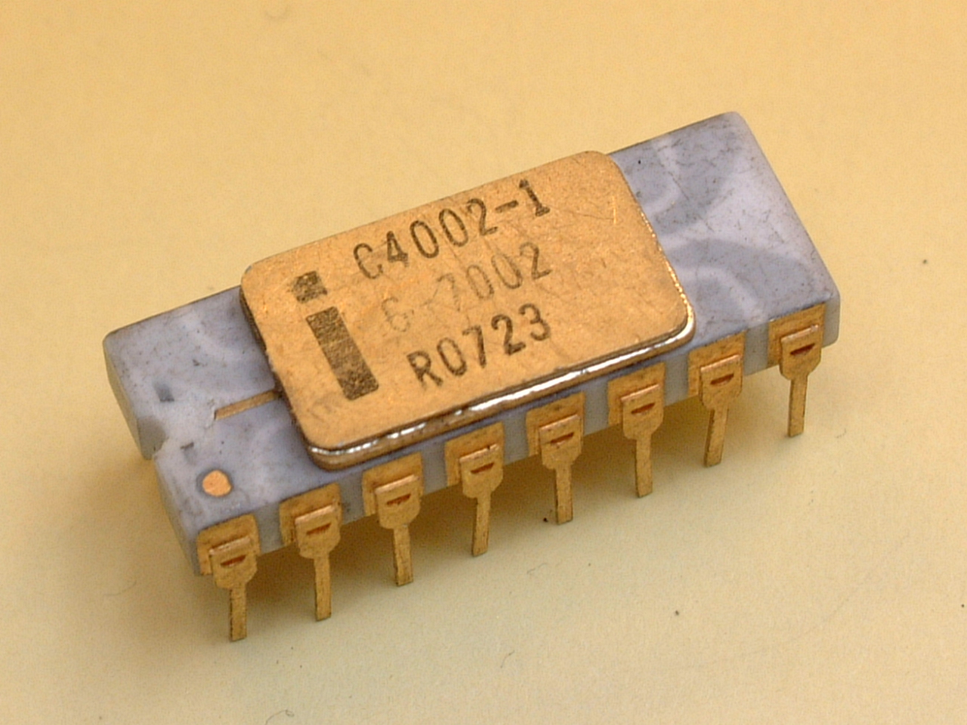
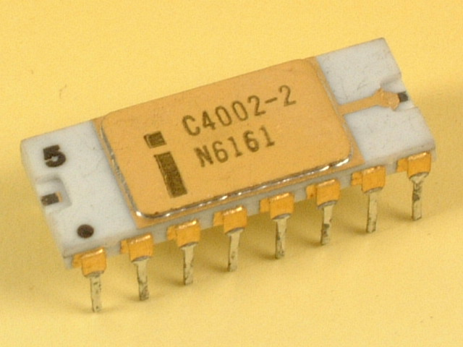

Slide 28
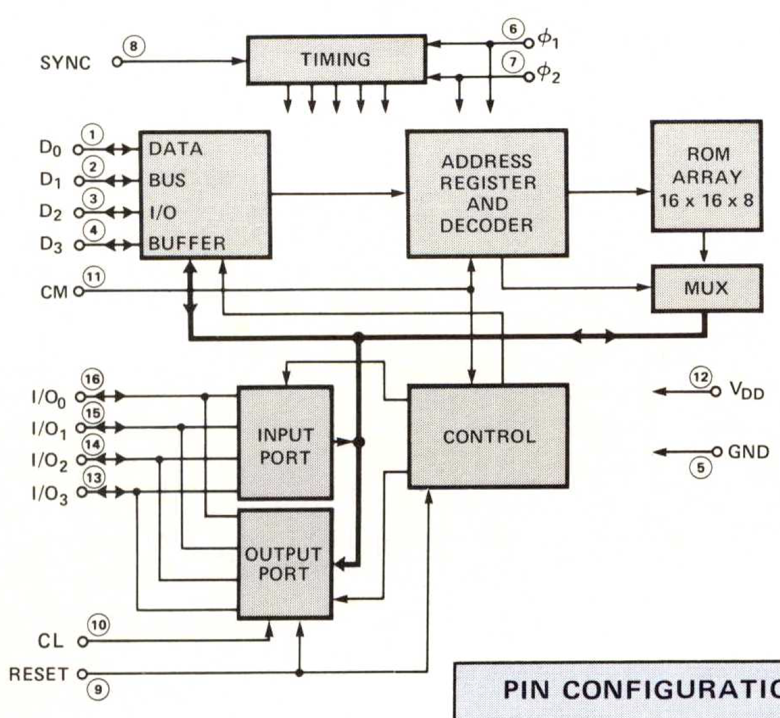
Introduction date: | 1971
Type: | Fully Decoded Static Random Access Memory..
Memory: | 256 x 8-bit
Technology: | P-channel silicon gate MOS technology (10 microns)
Number of transistors:
History: | The 4001 is a 256 x 8-bit ROM designed to be used with other MCS-4/40 devices such as the 4004 CPU.
Reset
9
8
Sync-Out
Clear input
I/O Lines
P₀
10
7
Clk Phase 2
Memory
Control
Input
CM
Clk Phase 1
11
6
-15v V_{DD}
5
V_{SS}
12
i4001
PINS
O₃
13
4
D3
9
8
10
7
O₂
14
3
D2
11
Output
Lines
Data
Bus
I/O
6
12
5
O₁
15
2
D1
13
4
3
O₀
16
1
D0
14
15
2
16
1

Slide 29
TIMING
6
⏀₁
Intel 4001
SYNC
8
7
⏀₂
DATA
BUS
I/O
BUFFER
ADDRESS
REGISTER
AND
DECODER
ROM
ARRAY
16 X 16 X 8
D₀
1
D₁
2
D₂
3
D₃
4
CM
11
MUX
I/O₀
16
I/O₁
INPUT PORT
CONTROL
15
V_{DD}
I/O₂
14
12
I/O₃
13
GND
5
OUTPUT PORT
CL
10
RESET
9

Slide 30
Output from Busicom-141PF Calculator ROM disassembly - First 32 words
Pyntel4004 Disassembler
Source Code *
0 240 clb
1 17, 1 jcn(1,1)
3 80, 176 jms(176)
5 81, 95 jms(95)
7 173 ld(13)
8 177 xch(1)
9 240 clb
10 81, 95 jms(95)
12 173 ld(13)
13 28, 41 jcn(12,41)
15 104 inc(8)
16 81, 115 jms(115)
18 39 src(3)
19 236 rd0
20 245 ral
21 179 xch(3)
22 104 inc(8)
23 240 clb
24 81, 160 jms(160)
26 243 cmc
27 179 xch(3)
28 245 ral
29 225 wmp
30 102 inc(6)
31 39 src(3)
32 234 rdr
000 clb
001 jcn TZ $001
003 jms $0b0
005 jms $15f
007 ld 13
008 xch 1
009 clb
00a jms $15f
00c ld 13
00d jcn AN $029
00f inc 8
010 jms $173
012 src 3<
013 rd0
014 ral
015 xch 3
016 inc 8
017 clb
018 jms $1a0
01a cmc
01b xch 3
01c ral
01d wmp
01e inc 6
01f src 3<
020 rdr
* https://www.4004.com/2009/Busicom-141PF-Calculator_asm_rel-1-0-1.txt

Slide 31
